Slide 1
Predictions on stock price change with data mining
in top news
HE Junyi YANG Haobo ZHANG Bowen WU Zijing

Slide 2
1
INTRODCTION
2
LOGISTIC REGRESSION
3
RANDOM FOREST
CONTENTS
4
COMBINATION OF CNN AND LSTM
5
TIME SERIES
6
CONCLUSION

Slide 3
01
INTRODCTION

Slide 4
Introduction
Data from Kaggle, news, DJIA, stock price
News headline
Historical stock data
Combined dataset
Open High Low Close AdjClose Volume
Top 25 headlines
News headlines
Lable
Reddit WorldNews Channel
Yahoo Finance
Kaggle
Range: 2008-06-08 to 2016-07-01
Range: 2008-08-08 to 2016-07-01
Range: 2008-08-08 to 2016-07-01

Slide 5
Example
Nobel Prize in Physics awarded to Saul Permutter, Brian P Schmidt and Adam G Riess for for the discovery of the accelerating expansion of the Universe through observations of distant supernovae
Trans-Pacific Partnership Trade Deal Is Reached
A young British woman has become one of the first cancer patients to be injected with a new vaccine designed to stimulate the immune system so that it destroys tumours wherever they have spread in the body
Pat Robertson defrauded millions in aid donations to fund a diamond mining venture in the Congo
618 Rhinos killed already in South Africa this year.
Tsunami alert as Chile hit by powerful 7.9 earthquake

Slide 6
02
RANDOM FOREST

Slide 7
Data Pre-Processing
Data set
Trainingset
85%
Training set and test set
Data set
The first stage is to divide it into training set and test set, here we assign the earliest 85% of the whole data to training set in date order(from early to latest), and assign the rest 15% to test set.
Test set
15%

Slide 8
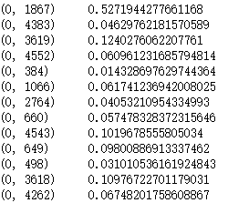
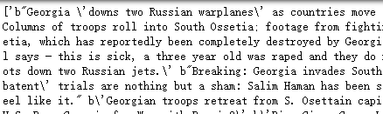
Data Pre-Processing
Transform text
We use the function “TfidfVectorizer” in python.
Here use the hyper parameter “min_df” and “max_df” to ignore some terms. Min_df is set to be 0.01 which means the least frequent 1% of terms is ignored; max_df is set to be 0.99 denoting the most frequent 1% terms is ignored, for example, some words such as “ a, the, is, are” need to be ignored, otherwise, these words can make noises in training trees in the random forest.
“ a, the, is, are”
Tansfrom text into TF-IDF-weighted document-term matrix
Text
TF-IDF-weighted document-term matrix

Slide 9
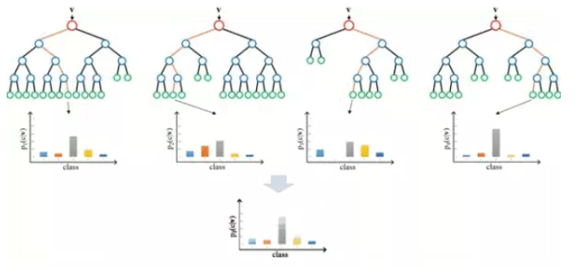
Random Forest
How it works
The first four graphs are CART (Classification and Regression Tree).
After randomly choosing samples and variables from the whole population and then input them into the random forest model, many trees could be generated.
The next stage is input the test set into these trees and each tree is able to make a prediction. Finally, the final decision could be made by combining each prediction with a function.

Slide 10
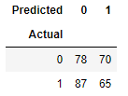
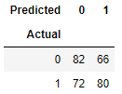
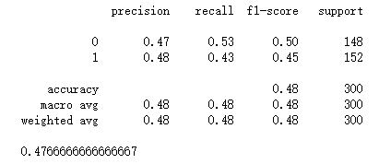
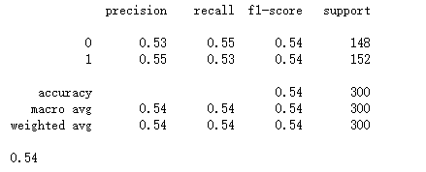
Accuracy
one-gram dataset
Two-gram dataset
accuracy : 0.47666667
accuracy : 0.54
Improve acuracy
change the“ngtam_range=(1,1)”
to
“ngtam_range(2,2)”,

Slide 11
03
LOGISTIC REGRESSION

Slide 12
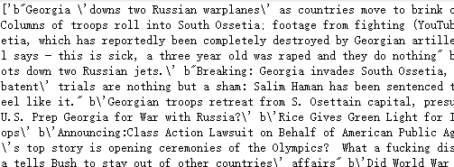
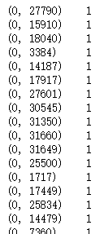
Data Processing
Original Dataset
CountVectorizer
A matrix of TF-IDF(Term frequency-Inverse Doc Frequency)

Slide 13
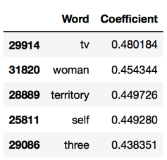
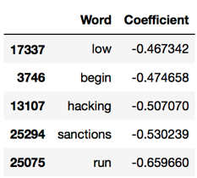
Data Processing
Top5
coefficient _1
Tail5
coefficient _1

Slide 14
Modeling1-Logistic Regression with One-gram Dataset
Top5
coefficient _1
Tail5
coefficient _1

Slide 15
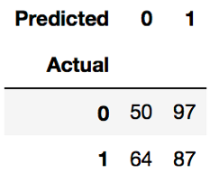
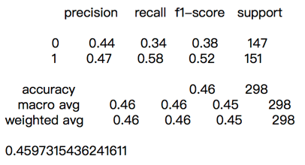
Modeling1-Logistic Regression with One-gram Dataset
The accuracy of this model is only 45.97%, which is significantly lower than Random speculation (50%).
When the interest class is “1” (i.e. the trend of DJIA would increase), the precision is 0.4597, which means that of the 184 cases that the model predicts it will rise and 87 truly happen.
Confusion Matrix_1
The recall is 0.58, which means that only 87 cases are retrieved by the model in the 151 cases that happened
F-score is only 0.52 for the 1-gram logistic regression model
Performance Measure_1

Slide 16
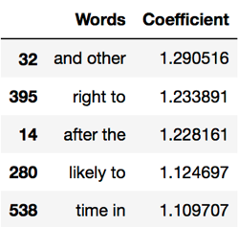
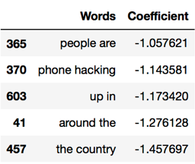
Modeling2-Logistic Regression with Two-gram Dataset
Top5
coefficient _2
Tail5
coefficient _2

Slide 17
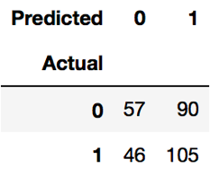
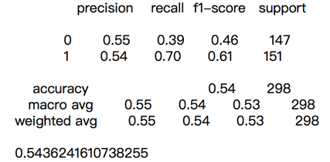
Modeling2-Logistic Regression with Two-gram Dataset
It is clearly showing that the accuracy of two-gram logistic regression is obviously enhanced from 0.4597 to 0.5436.
When the interest class is ‘1”, the precision is 0.54, meaning 105 cases will truly rise with the total 195 cases predicted by the model.
Confusion Matrix_2
The recall of 0.70 shows that 105 cases retrieved by the model with 151 cases that actually happened
F-score is now 0.61 and closer to 1 than the previous one, indicating the 2-gram logistic regression is better than 1-gram.
Performance Measure_2

Slide 18
04
COMBINATION OF CNN AND LSTM

Slide 19
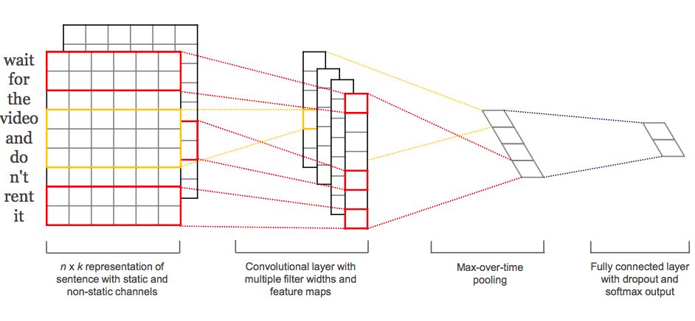
The idea of using CNN to do Sentence Classification
Convolutional Neural Networks for Sentence Classification by Yoon Kim, 2014
1. Despite little tuning of hyperparameters, a simple CNN with one layer of convolution performs remarkably well. Kim (2014)
2. Our results add to the well-established evidence that unsupervised pre-training of word vectors is an important ingredient in deep learning for NLP. Kim (2014)

Slide 20

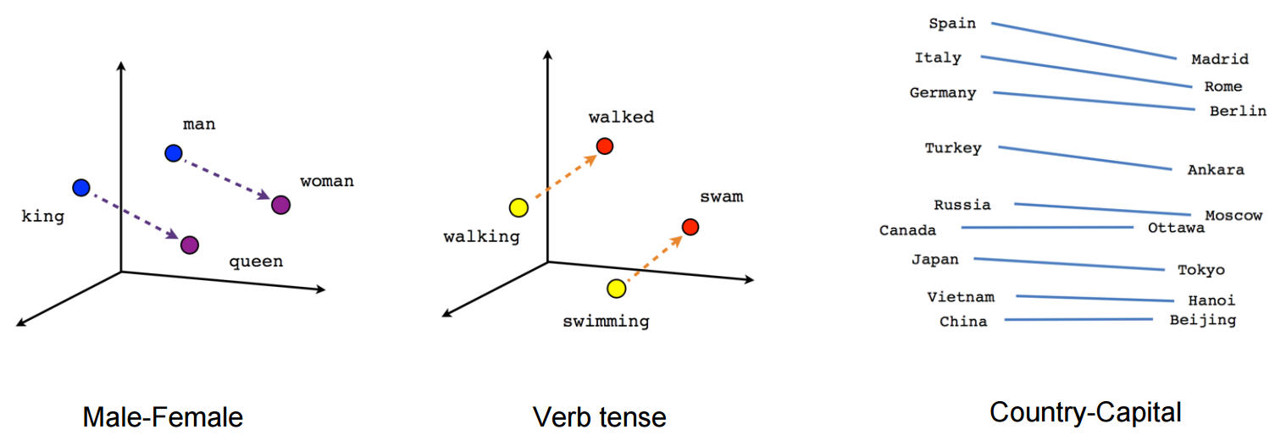

Data Cleaning and Pre-Processing
Remove unwanted characters
Normaliztion
Word Embedding

Slide 21
Word Embedding
word 1
Index of word 1
Word Vector 1
word 2
Index of word 2
…
Word Vector 2
word 3
Index of word 3
Word Vector 3
Embedding Layer
Jeffrey Pennington, Richard Socher, and Christopher D. Manning. 2014. GloVe: Global Vectors for Word Representation

Slide 22
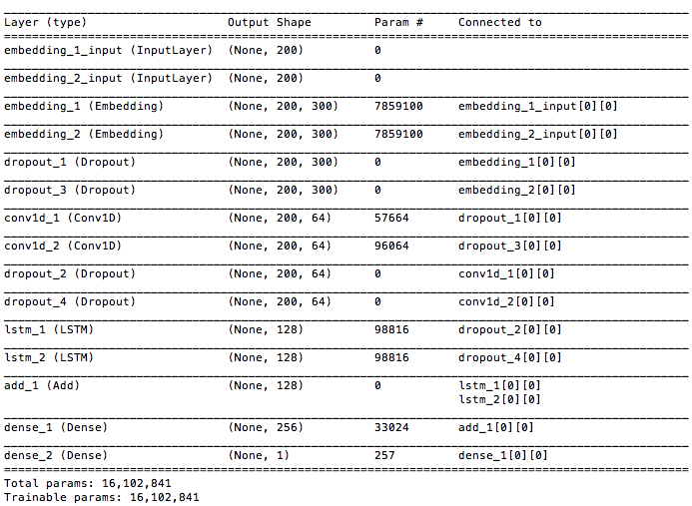
Model Construction
The mixed model of CNN and RNN takes advantage of the coarse-grained local features in CNN and long-distance dependencies learned by RNN

Slide 23

Input
Embedding layer
CNN
LSTM
Concatenation Layer
Dense Layer
Output
…
I
love
.
.
.
.
.
.
data
Filter length = 3
mining
……
…
!
<PAD>
<PAD>
<PAD>
…
Embedding Dimension
Filter length = 5

Slide 24
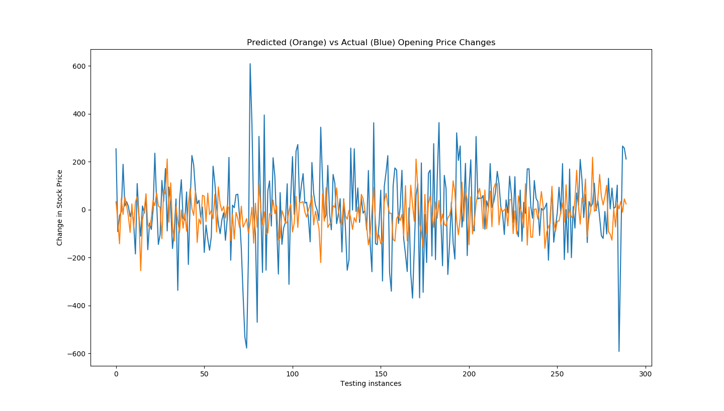
Results
As shown in figure , the orange line shows our predicted change in stock price. The predict accuracy is 58.97%.

Slide 25
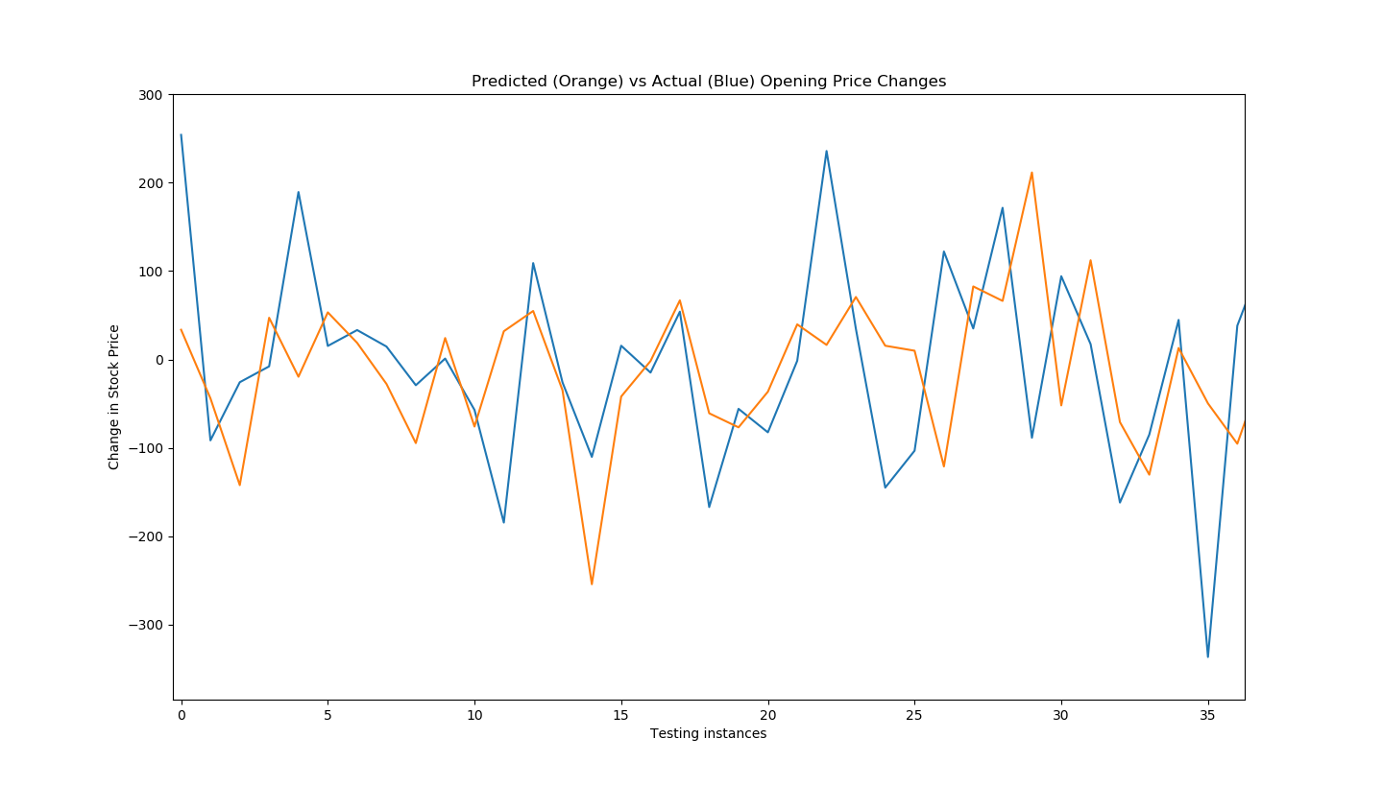
Results
Our model can detect many significant changes in stock price, like increasing to decreasing in a very short time.

Slide 26
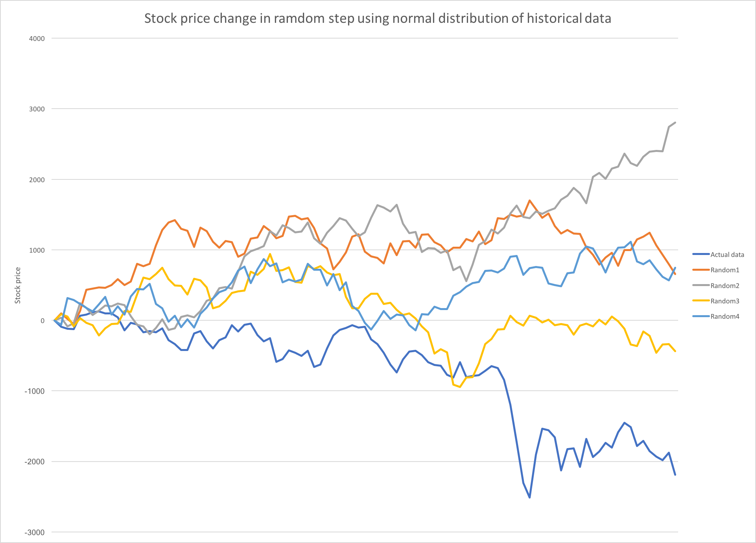
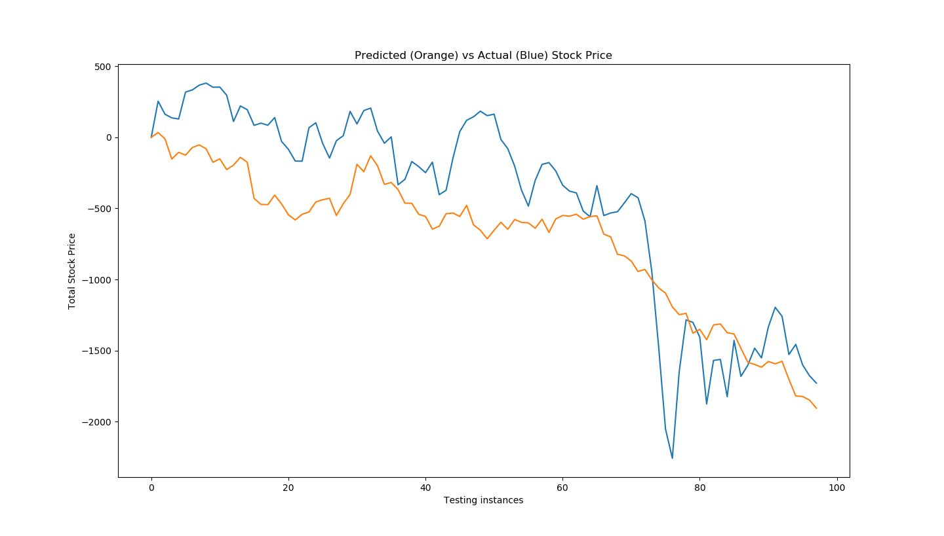
Results
Surprisingly, given the stock price of first day, 2015.1.1, to be 0, our predictions fit the actual data well in a long term

Slide 27
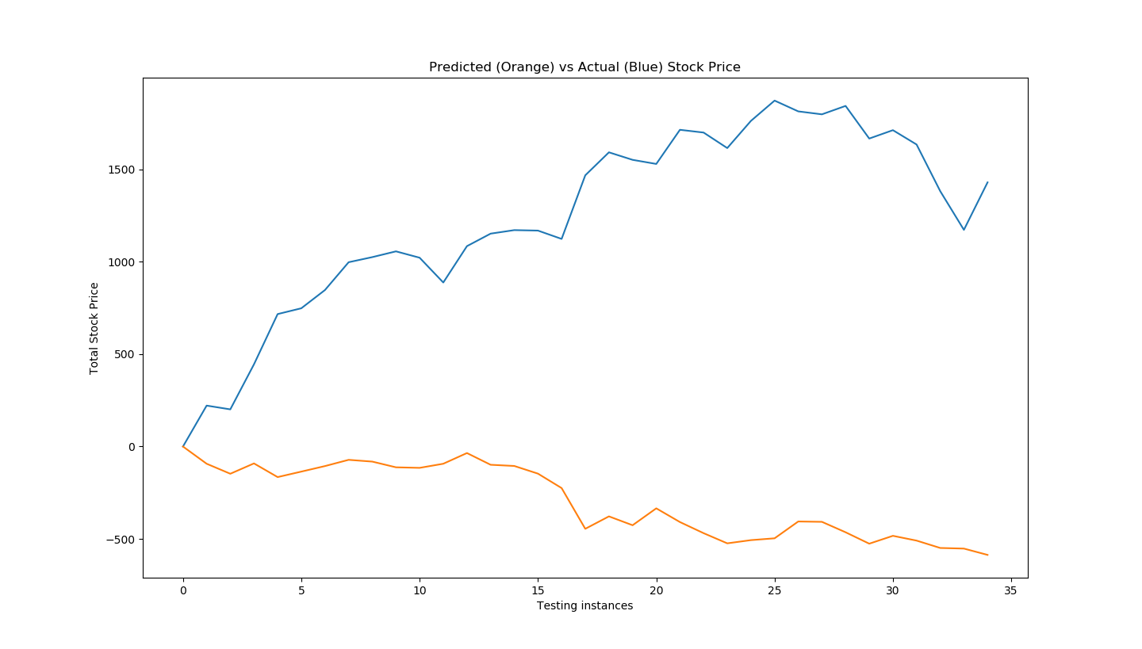
Results (Drawbacks)
This model cannot learn from historical data and are not sensitive to increasing tendency. The drawbacks can be obviously viewed in the predicted 35 days data from 2015.10.01.

Slide 28
05
TIME SERIES

Slide 29
Time Series Analysis vs. Text Analysis on Stock Price Prediction
Based on historical data
Time delay
Hard to detect sudden change
Based on news
Not sensitive to increasing tendency
Cannot learn from historical data
Time Series
Text Analysis

Slide 30

LSTM Model Construction
One LSTM layer of 4 blocks
LSTM
Xt=f(Xt−1, Θ)
One dense layer
MSE is used as loss function
epochs=20

Slide 31
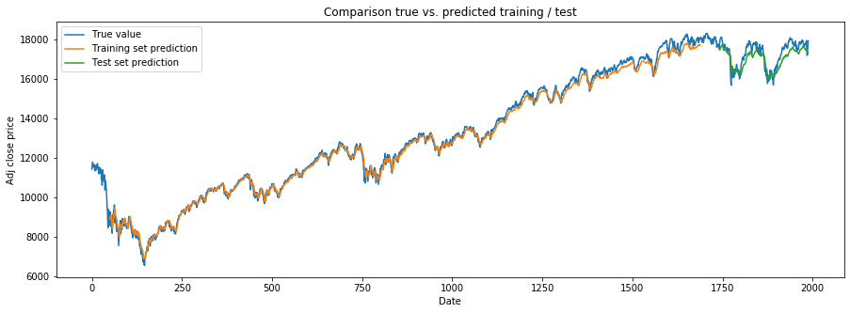
Results

Slide 32
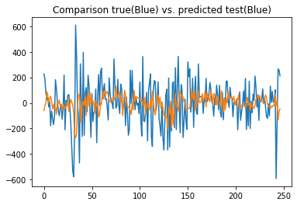
Results
The accuracy of predicting the tendency of stock price is 0.554656

Slide 33
Future Work
Time series
LSTM
COMBINED MODEL
题文本预设
Text analysis
LSTM+CNN

Slide 34
06
CONCLUSION
Code available on https://github.com/Dotafterfootball/MFIT5004

Slide 35
THANK YOU
Q & A
HE Junyi YANG Haobo ZHANG Bowen WU Zijing

